Slide 1



Minor project
M sic player
(Web app)
MEMBER:-
Mohammad Yusuf Khan

Slide 2

Table of content
Introduction
Problem Identification
Methodology
Result
Conclusion
Reference Websites

Slide 3
Introduction
In this music player, users can play online music.
A user can add there friends.
The user can make a playlist.
Users can send their favourite songs to friends.
User can play music in group

Slide 4
Problem Identification
Now in these days. Music is also a part of life, but we have many devices, and your playlist is saved on that particular device. If we change our device, we are then unable to access our play list.
In the general music player app, we are unable to share your favourite song, and there is no option to add friends.

Slide 5
Problem Identification
When we get together in a group, we enjoy playing songs, but in order to do so, we must download some applications that may not work properly.
Other music players are operating system dependent.

Slide 6
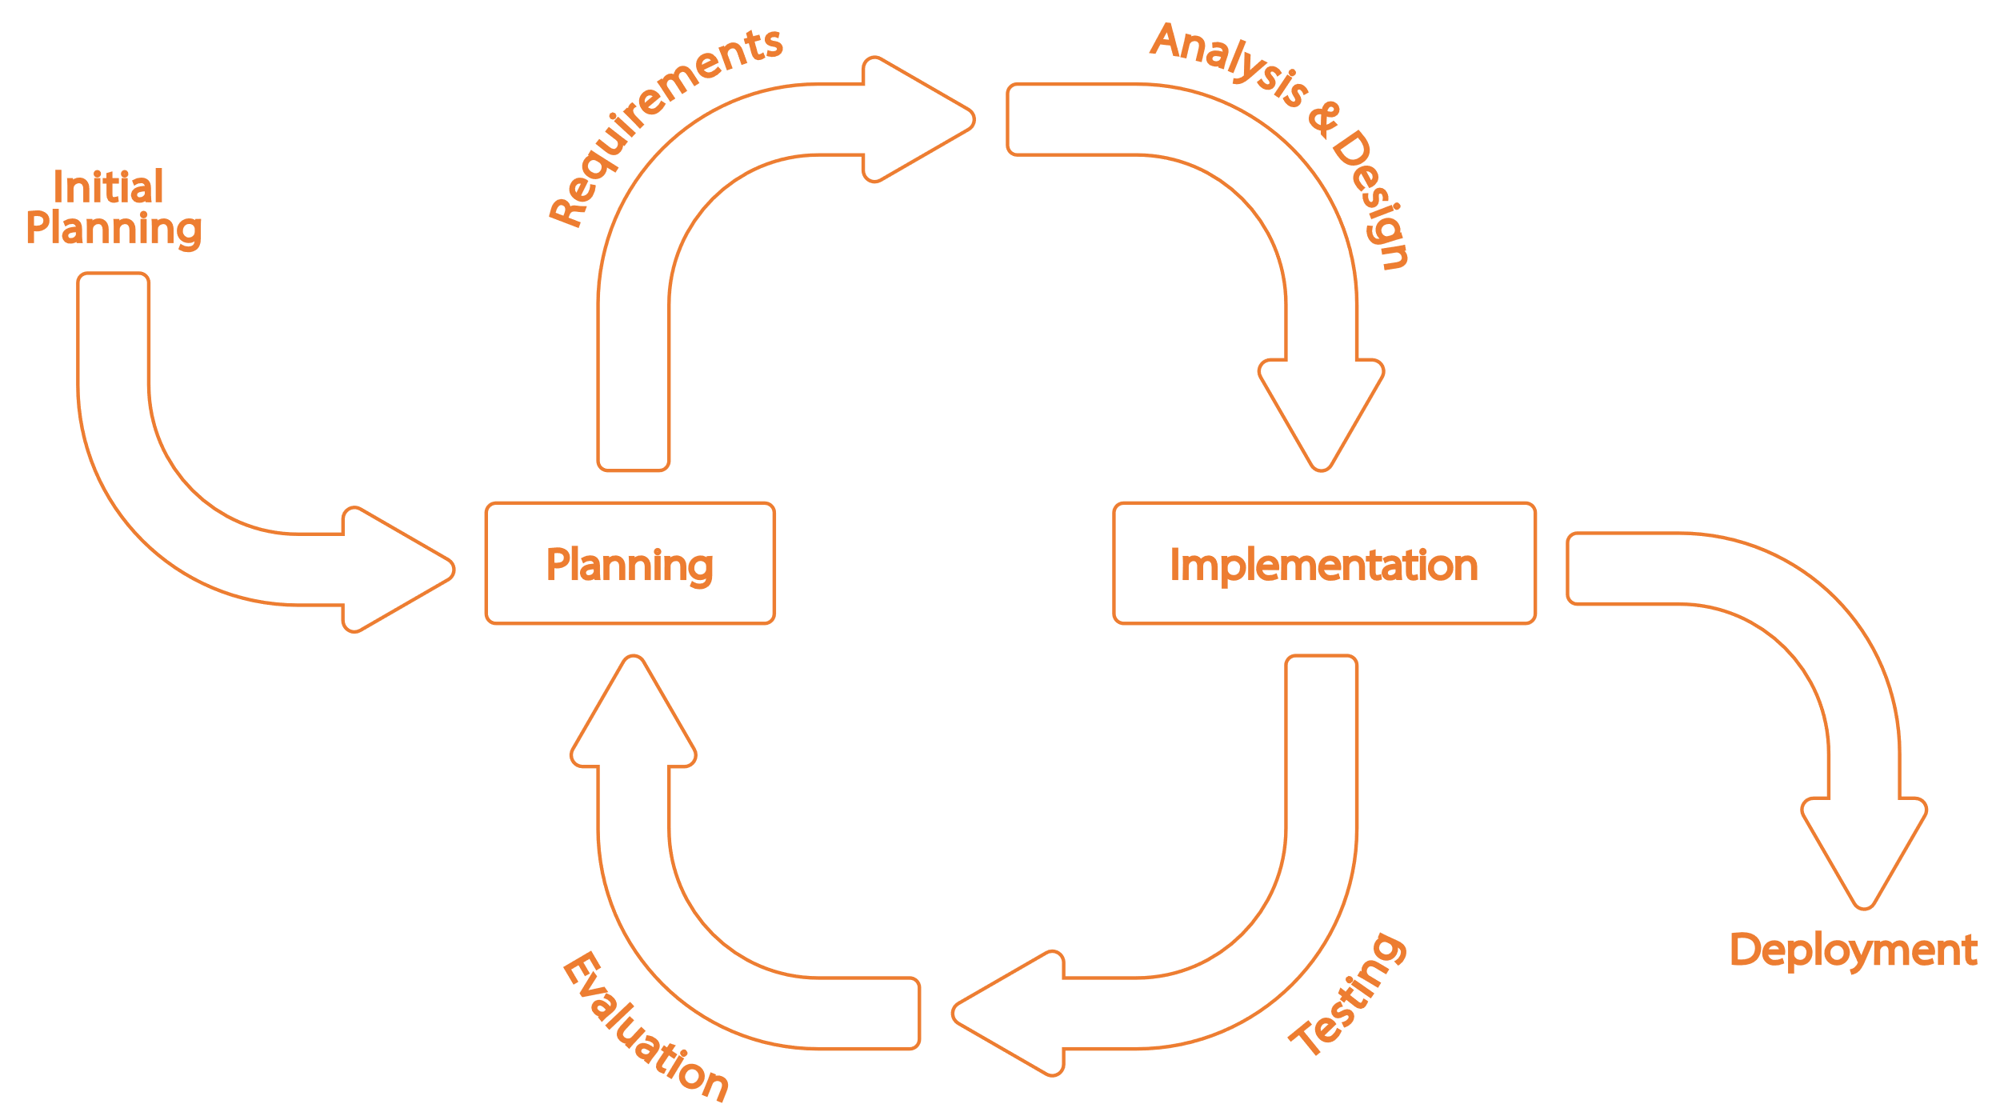
Methodology
Incremental Model

Slide 7
Result and discussion

Slide 8
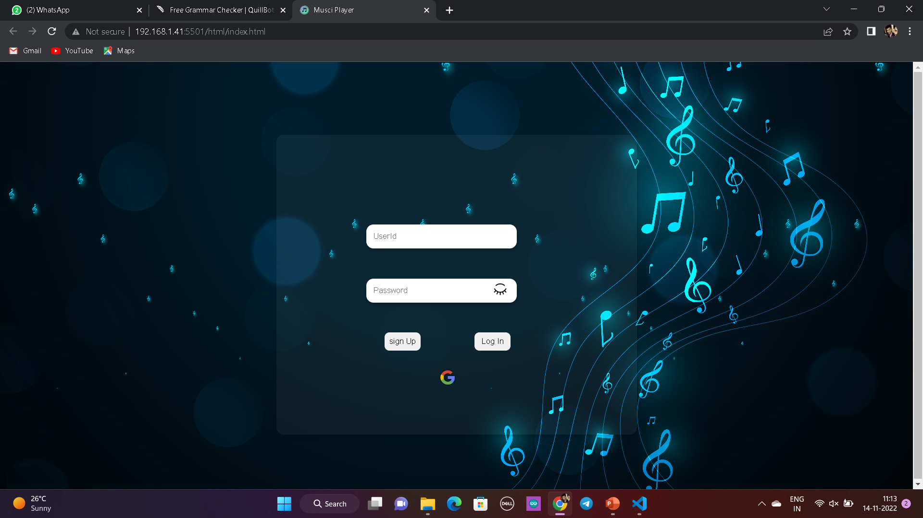

Slide 9
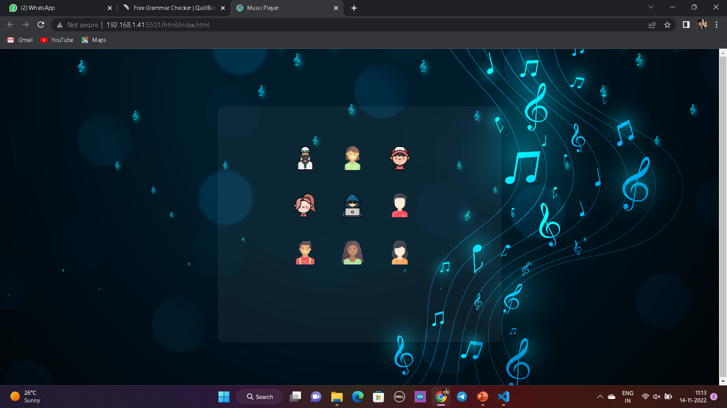

Slide 10
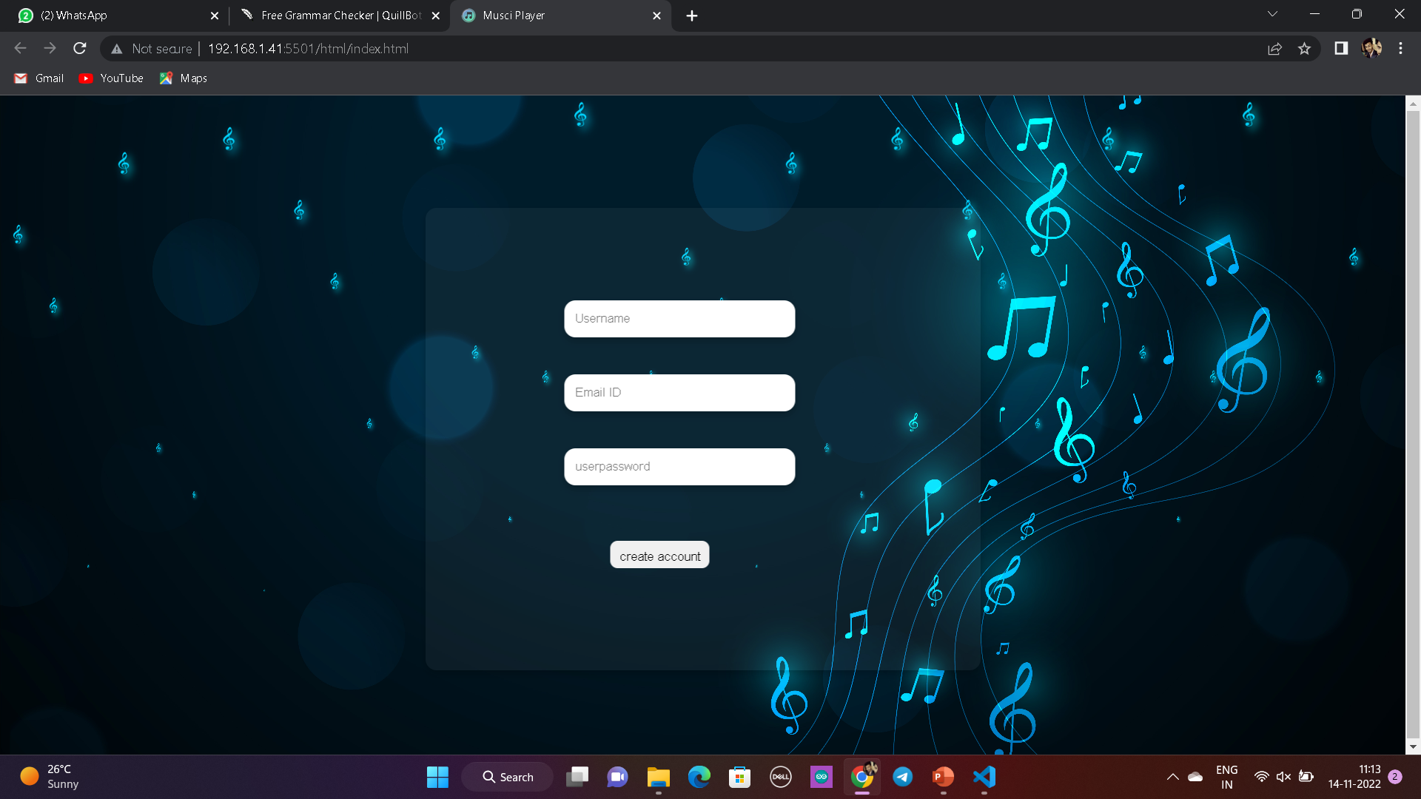

Slide 11
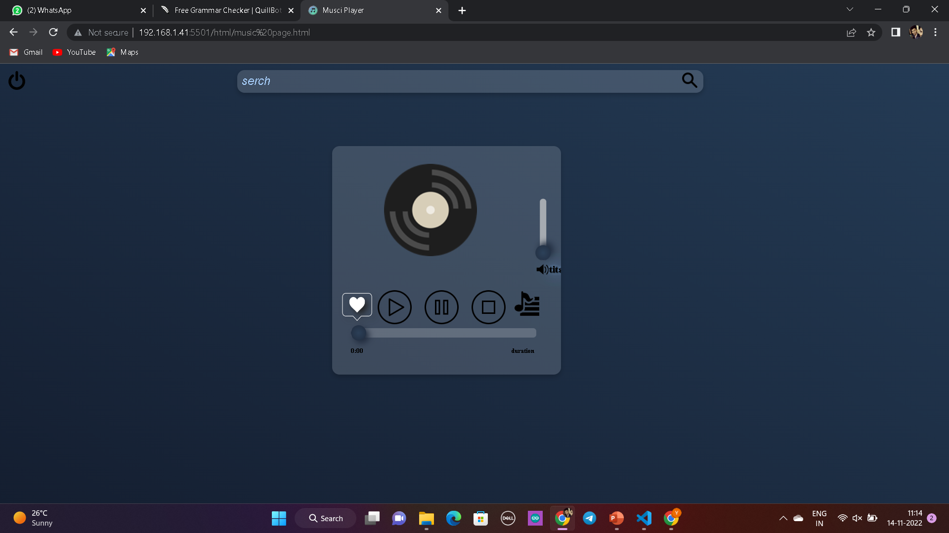

Slide 12
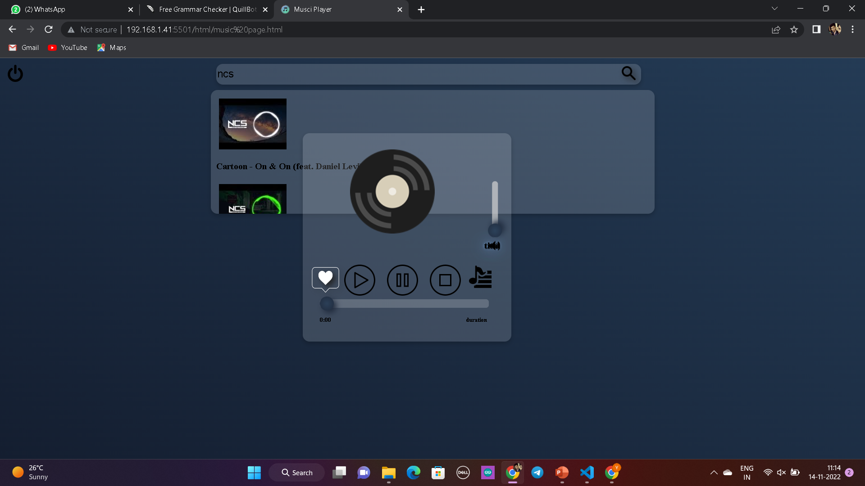

Slide 13
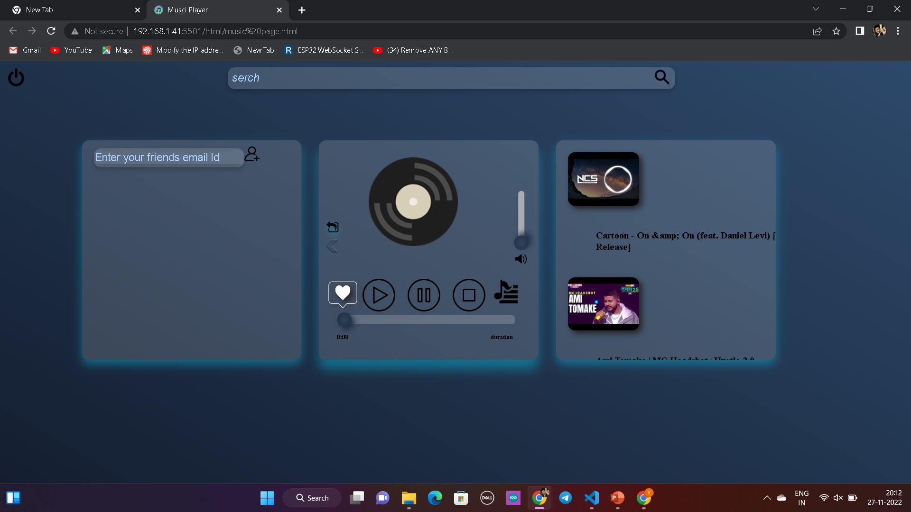

Slide 14
Thank you

